Slide 1
Client-side Validation
We’ll be using
PHP to create the forms
JavaScript to perform client-side validation to ensure that the data is as complete and correct as it can be before it is submitted.
Remember though:
Final validation of the input will then be made by PHP, which will, if necessary, present the form again to the user for further modification

Slide 2
Validating User Input with JavaScript
JavaScript validation should be considered an assistance more to your users than to your websites because, as I have already stressed many times, you cannot trust any data submitted to your server, even if it has supposedly been validated with JavaScript.
This is because hackers can quite easily simulate your web forms and submit any data of their choosing.
Another reason you cannot rely on JavaScript to perform all your input validation is that some users disable JavaScript, or use browsers that don’t support it.

Slide 3
Validating User Input with JavaScript
So the best types of validation to do in JavaScript are:
Checking that fields have content if they are not to be left empty
Ensuring that email addresses conform to the proper format
Ensuring that values entered are within expected bounds

Slide 4
The validate.html Document
Let’s see an example beginning with a general sign-up form, common on most sites that offer memberships or registered users.
The inputs requested will be forename, surname, username, password, age, and email address. See next slide…

Slide 5
<!DOCTYPE html>
<html>
<head>
<title>An Example Form</title>
<style>
.signup {
border:1px solid #999999; font: normal 14px helvetica; color: #444444;
}
</style>
<script>
function validate(form) {
fail = validateForename(form.forename.value)
fail += validateSurname(form.surname.value)
fail += validateUsername(form.username.value)
fail += validatePassword(form.password.value)
fail += validateAge(form.age.value)
fail += validateEmail(form.email.value)
if (fail == "") return true
else { alert(fail); return false }
}
</script>
</head>
The first few lines set up the document and use a little CSS to make the form look a little less plain

Slide 6
<!DOCTYPE html>
<html>
<head>
<title>An Example Form</title>
<style>
.signup {
border:1px solid #999999; font: normal 14px helvetica; color: #444444;
}
</style>
<script>
function validate(form) {
fail = validateForename(form.forename.value)
fail += validateSurname(form.surname.value)
fail += validateUsername(form.username.value)
fail += validatePassword(form.password.value)
fail += validateAge(form.age.value)
fail += validateEmail(form.email.value)
if (fail == "") return true
else { alert(fail); return false }
}
</script>
</head>
Between the <script> and </script> tags lies a single function called validate that itself calls up six other functions to validate each of the form’s input fields.
They return either an empty string if a field validates, or an error message if it fails.
If there are any errors, the final
line of the script pops up an alert box to display them.
The return values from validate are important, because if it returns false, the form is prevented from being submitted

Slide 7
<body>
<table border="0" cellpadding="2" cellspacing="5" bgcolor="#eeeeee">
<th colspan="2" align="center">Signup Form</th>
<form method="post" action="adduser.php" onsubmit="return validate(this)">
<tr><td>Forename</td>
<td><input type="text" maxlength="32" name="forename"></td></tr>
<tr><td>Surname</td>
<td><input type="text" maxlength="32" name="surname"></td></tr>
<tr><td>Username</td>
<td><input type="text" maxlength="16" name="username"></td></tr>
<tr><td>Password</td>
<td><input type="text" maxlength="12" name="password"></td></tr>
<tr><td>Age</td>
<td><input type="text" maxlength="3" name="age"></td></tr>
<tr><td>Email</td>
<td><input type="text" maxlength="64" name="email"></td></tr>
<tr><td colspan="2" align="center"><input type="submit"
value="Signup"></td></tr>
</form>
</table>
</body>
</html>
Notes:
As you can see, the only JavaScript used within the form’s HTML is the call to return buried in the onSubmit attribute.
Browsers with JavaScript disabled or not available will simply ignore the onSubmit attribute, and the HTML will display just fine.

Slide 8
<body>
<table border="0" cellpadding="2" cellspacing="5" bgcolor="#eeeeee">
<th colspan="2" align="center">Signup Form</th>
<form method="post" action="adduser.php" onsubmit="return validate(this)">
<tr><td>Forename</td>
<td><input type="text" maxlength="32" name="forename"></td></tr>
<tr><td>Surname</td>
<td><input type="text" maxlength="32" name="surname"></td></tr>
<tr><td>Username</td>
<td><input type="text" maxlength="16" name="username"></td></tr>
<tr><td>Password</td>
<td><input type="text" maxlength="12" name="password"></td></tr>
<tr><td>Age</td>
<td><input type="text" maxlength="3" name="age"></td></tr>
<tr><td>Email</td>
<td><input type="text" maxlength="64" name="email"></td></tr>
<tr><td colspan="2" align="center"><input type="submit"
value="Signup"></td></tr>
</form>
</table>
</body>
</html>
This is pretty straightforward HTML, with the exception of the onSubmit="return validate(this)" statement within the opening <form> tag.
Using onSubmit, you can cause a function of your choice to be called when a form is submitted.
That function can perform some checking and return a value of either true or false to signify whether the form should be allowed to be submitted.
Notes:
The this parameter is the current object (i.e., this form) and is passed to the validate function just discussed.
The validate function receives this parameter as the object form.

Slide 9
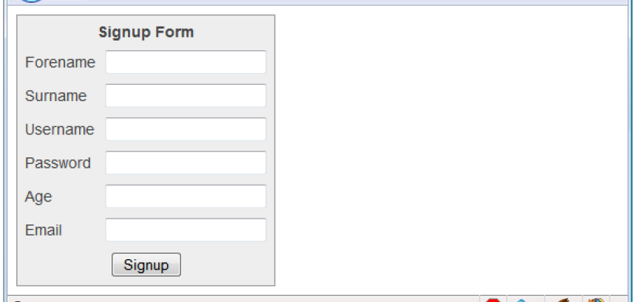
As it stands, this form will display correctly but will not self-validate, because the main validation functions have not yet been added.
Even so, save it as validate.html, and when you call it up in your browser, it will look like:

Slide 10
Validating the forename
If the value of the forename is the empty string, an error message is returned; otherwise, an empty string is returned to signify that no error was encountered.
A problem: If the user entered spaces in this field, it would be accepted by validateForename, even though it’s empty for all intents and purposes.
You can fix this by adding an extra statement to trim whitespace from the field before checking whether it’s empty, use a regular expression to make sure there’s something besides whitespace in the field, or, as I do here, just let the user make the mistake and allow the PHP program to catch it on the server.
function validateForename(field)
{
return (field == "") ? "No Forename was entered.\n" : ""
}

Slide 11
Validating the surname
The validateSurname function is almost identical to validateForename in that an error is returned only if the surname supplied was an empty string.
I chose not to limit the characters allowed in either of the name fields to allow for possibilities such as non-English and accented characters.
function validateSurname(field)
{
return (field == "") ? "No Surname was entered.\n" : ""
}

Slide 12
Validating the username
The validateUsername function has to allow through only the characters a-z, A-Z, 0-9, _ and -, and ensure that usernames are at least five characters long.
Then the JavaScript test function is called, passing a regular expression (which matches any character that is not one of those allowed) to be matched against field.
If even one character that isn’t one of the acceptable characters is encountered, the test function returns true, and so validateUser returns an error string.
function validateUsername(field)
{
if (field == "") return "No Username was entered.\n"
else if (field.length < 5)
return "Usernames must be at least 5 characters.\n"
else if (/[^a-zA-Z0-9_-]/.test(field))
return "Only a-z, A-Z, 0-9, - and _ allowed in Usernames.\n"
return ""
}
Notes:
Avoid “magic numbers” though, it is just an example

Slide 13
Validating the password
First the function checks whether field is empty, and if it is, returns an error. Next, an error message is returned if a password is shorter than six characters.
One of the requirements we’re imposing on passwords is that they must have at least one each of a lowercase, uppercase, and numerical character, so the test function is called three times, once for each of these cases.
function validatePassword(field)
{
if (field == "") return "No Password was entered.\n"
else if (field.length < 6)
return "Passwords must be at least 6 characters.\n"
else if (!/[a-z]/.test(field) || ! /[A-Z]/.test(field) ||!/[0-9]/.test(field))
return "Passwords require one each of a-z, A-Z and 0-9.\n"
return ""
}

Slide 14
Validating the age
validateAge returns an error message if field is not a number (determined by a call to the isNaN function), or if the age entered is lower than 18 or greater than 110.
Your applications may well have different or no age requirements.
function validateAge(field)
{
if (isNaN(field)) return "No Age was entered.\n"
else if (field < 18 || field > 110)
return "Age must be between 18 and 110.\n"
return ""
}

Slide 15
Validating the email
After checking whether anything was actually entered, and returning an error message if it wasn’t, the function calls the JavaScript indexOf function twice.
The first time a check is made to ensure there is a period (.) somewhere from at least the second character of the field, and the second checks that an @ symbol appears somewhere at or after the second character.
If those two checks are satisfied, the test function is called to see whether any disallowed characters appear in the field.
function validateEmail(field)
{
if (field == "") return "No Email was entered.\n"
else if (!((field.indexOf(".") > 0) && (field.indexOf("@") > 0)) || /[^a-zA-Z0-9.@_-]/.test(field))
return "The Email address is invalid.\n"
return ""
}
Notes:
The allowed characters in an email address are uppercase and lowercase letters, numbers, and the _, -, period, and @ characters, as detailed in the regular expression passed to the test method. If no errors are found, the empty string is returned to indicate successful validation.

Slide 16
Using a separate JavaScript file
Of course, because they are generic in construction and could apply to many types of validations you might require, these six functions make ideal candidates for moving out into a separate JavaScript file.
You could name the file something like validate_functions.js and include it right after the initial script section using the following statement:
<script src="validate_functions.js"></script>

Slide 17
Regular Expressions
Let’s look a little more closely at the pattern matching we have been doing.
We’ve achieved it using regular expressions, which are supported by both JavaScript and PHP.
They make it possible to construct the most powerful of pattern-matching algorithms within a single expression.

Slide 18
Matching Through Metacharacters
Every regular expression must be enclosed in slashes.
Within these slashes, certain characters have special meanings; they are called metacharacters.
For instance, an asterisk (*) means, “The text you’re trying to match may have any number of the preceding characters—or none at all.”

Slide 19
Matching Through Metacharacters
For instance, let’s say you’re looking for the name Le Guin and know that someone might spell it with or without a space.
Because the text is laid out strangely (for instance, someone may have inserted extra spaces to right-justify lines), you could have to search for a line such as this:
The difficulty of classifying Le Guin’s works
So you need to match LeGuin, as well as Le and Guin separated by any number of spaces.
The solution is to follow a space with an asterisk: /Le *Guin/
Notes:
There’s a lot more than the name Le Guin in the line, but that’s OK.
As long as the regular expression matches some part of the line, the test function returns a true value.

Slide 20
Regular Expressions
What if it’s important to make sure the line contains nothing but Le Guin?
I’ll show you how to ensure that later.
Suppose now that you know there is always at least one space.
In that case, you could use the plus sign (+), because it requires at least one of the preceding characters to be present:
/Le +Guin/

Slide 21
Fuzzy Character Matching
The dot (.) is particularly useful, because it can match anything except a newline.
Suppose that you are looking for HTML tags, which start with < and end with >
A simple way to do so is shown here: /<.*>/
The dot matches any character, and the * expands it to match zero or more characters, so this is saying, “Match anything that lies between < and >, even if there’s nothing.” You will match <>, <em>, <br>, and so on.

Slide 22
Fuzzy Character Matching
But if you don’t want to match the empty case, <>, you should use + instead of *, like this: /<.+>/
The plus sign expands the dot to match one or more characters, saying, “Match anything that lies between < and > as long as there’s at least one character between them”
Unfortunately, the plus sign keeps on matching up to the last > on the line, so you might end up with this:
<h1><b>Introduction</b></h1>

Slide 23
Regular Expressions
If you use the dot on its own between the angle brackets, without following it with either a + or *, then it matches a single character
If you want to match the dot character itself (.), you have to escape it by placing a backslash (\) before it, because otherwise it’s a metacharacter and matches anything.
As an example, suppose you want to match the floating-point number 5.0
The regular expression is as follows: /5\.0/
The backslash can escape any metacharacter, including another backslash (in case you’re trying to match a backslash in text).

Slide 24
Grouping Through Parentheses
Suppose you want to match powers of increments of units, such as kilo, mega, giga, and tera. In other words, you want all the following to match:
1,000
1,000,000
1,000,000,000
1,000,000,000,000
...
The plus sign works here, too, but you need to group the string ,000 so the plus sign matches the whole thing.
The regular expression is as follows: /1(,000)+ /
The parentheses mean “treat this as a group when you apply something such as a plus sign.”

Slide 25
Grouping Through Parentheses
Let’s add some notes on this regular expression: /1(,000)+ /
1,00,000 and 1,000,00 won’t match because the text must have a 1 followed by one or more complete groups of a comma followed by three zeros.
The space after the + character indicates that the match must end when a space is encountered.
Without it, 1,000,00 would incorrectly match because only the first 1,000 would be taken into account, and the remaining ,00 would be ignored.
Notes:
Requiring a space afterward ensures that matching will continue right through to the end of a number.

Slide 26
Character Classes
Sometimes you want to match something fuzzy, but not so broad that you want to use a dot.
One of the key features supporting fuzzy matching is the pair of square brackets, []
It matches a single character, like a dot, but inside the brackets you put a list of things that can match. If any of those characters appears, the text matches.
For instance, if you wanted to match both the American spelling gray and the British spelling grey, you could specify the following:
/gr[ae]y/
The group of characters inside the brackets is called a character class

Slide 27
Indicating a Range
Inside the brackets, you can use a hyphen (ˈhaɪf^{ə}n) (-) to indicate a range.
One very common task is matching a single digit, which you can do with a range as follows:
/[0-9]/
Digits are such a common item in regular expressions that a single character is provided to represent them: \d
You can use it in place of the bracketed regular expression to match a digit:
/\d/

Slide 28
Negation
You can turn the whole character class on its head by placing a caret (^) after the opening bracket. Here it means, “Match any characters except the following.”
So let’s say you want to find instances of Yahoo that lack the following exclamation point. Here the regex:
/Yahoo[^!]/
NOTE: This is actually not a great solution to the problem—for instance, it fails if Yahoo is at the end of the line, because then it’s not followed by anything, whereas the brackets must match a character.
A better solution involves negative lookahead (matching something that is not followed by anything else), but we’ll not see that.
Notes:
The name of the company officially contains an exclamation point!

Slide 29
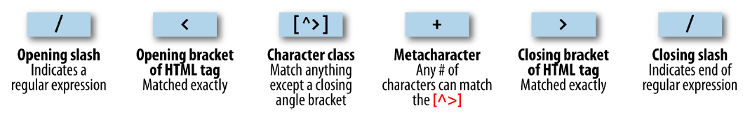
Some More-Complicated Examples
Let’s now see a better solution to the problem of matching an HTML tag.
This solution avoids going past the end of a single tag, but still matches tags such as <em> and </em> as well as tags with attributes such as this: <a href="www.mozilla.org">
Here is one solution: /<[^>]+>/

Slide 30
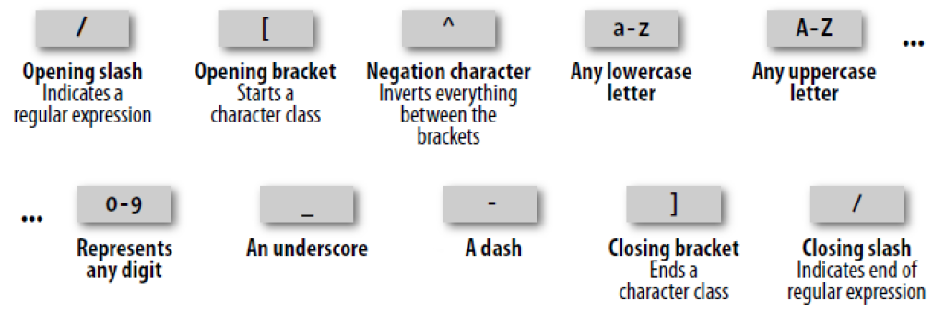
Some More-Complicated Examples
In validateUsername function we used:
/[^a-zA-Z0-9_-]/

Slide 31
Some More-Complicated Examples
There are two other important metacharacters. They “anchor” a regular expression by requiring that it appear in a particular place.
If a caret(ˈkærɪt) (^) appears at the beginning of the regular expression, the expression has to appear at the beginning of a line of text; otherwise, it doesn’t match.
Similarly, if a dollar sign ($) appears at the end of the regular expression, the expression has to appear at the end of a line of text.
So ,what if you want a line that has “Le Guin” and nothing else?
/^Le *Guin$/
Notes:
It may be somewhat confusing that ^ can mean “negate the character class” inside square brackets and “match the beginning of the line” if it’s at the beginning of the regular expression. Unfortunately, the same character is used for two different things, so take care when using it.

Slide 32
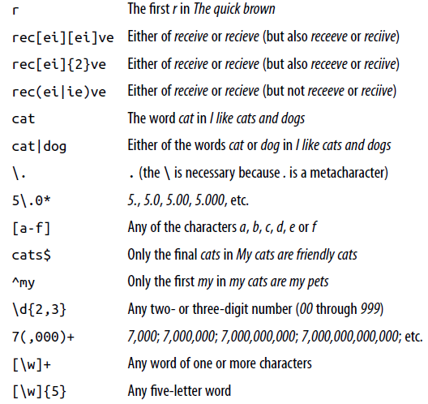
Notes:
Other examples

Slide 33
Using Regular Expressions in JavaScript
In JavaScript, you will use regular expressions mostly in two methods: test (which you have already seen) and replace
Whereas test just tells you whether its argument matches the regular expression, replace takes a second parameter: the string to replace the text that matches.
Like most functions, replace generates a new string as a return value; it does not change the input.
To compare the two methods, the following statement just returns true to let us know that the word cats appears at least once somewhere within the string:
document.write(/cats/i.test("Cats are funny. I like cats."))

Slide 34
Using Regular Expressions in JavaScript
But the following statement replaces both occurrences of the word cats with the word dogs, printing the result.
The search has to be global (/g) to find all occurrences, and case-insensitive (/i) to find the capitalized Cats:
document.write("Cats are friendly. I like cats.".replace(/cats/gi,"dogs"))
/g enables global matching. When using a replace function, specify this modifier to replace all matches, rather than only the first one.
/i makes the regular expression match case-insensitive. Thus, instead of /[a-zAZ]/
you could specify /[a-z]/i or /[A-Z]/i.

Slide 35
Using Regular Expressions in PHP
The most common regular expression functions that you are likely to use in PHP are preg_match, preg_match_all, and preg_replace.
To test whether the word cats appears anywhere within a string, in any combination of upper- and lowercase, you could use preg_match like this:
$n = preg_match("/cats/i", "Cats are crazy. I like cats.");
Because PHP uses 1 for TRUE and 0 for FALSE, the preceding statement sets $n to 1.

Slide 36
Using Regular Expressions in PHP
But preg_match is actually a good deal more powerful and complicated, because it takes a third argument that shows what text matched:
$n = preg_match("/cats/i", "Cats are curious. I like cats.", $match);
echo "$n Matches: $match[0]";
The third argument is an array (here, given the name $match). The function puts the text that matches into the first element, so if the match is successful, you can find the text that matched in $match[0].
In this example, the output lets us know that the matched text was capitalized:
1 Matches: Cats

Slide 37
Using Regular Expressions in PHP
If you wish to locate all matches, you use the preg_match_all function, like this:
$n = preg_match_all("/cats/i", "Cats are strange. I like cats.", $match);
echo "$n Matches: ";
for ($j=0 ; $j < $n ; ++$j) echo $match[0][$j]." ";
As before, $match is passed to the function and the element $match[0] is assigned the matches made, but this time as a subarray. To display the subarray, this example iterates through it with a for loop.

Slide 38
Using Regular Expressions in PHP
When you want to replace part of a string, you can use preg_replace as shown here.
This example replaces all occurrences of the word cats with the word dogs, regardless of case:
echo preg_replace("/cats/i", "dogs", "Cats are furry. I like cats.");

Slide 39
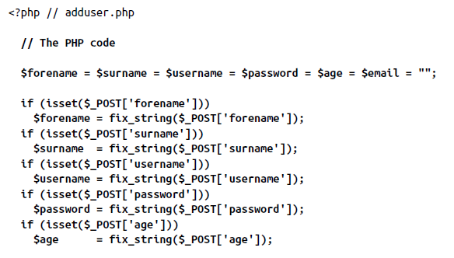
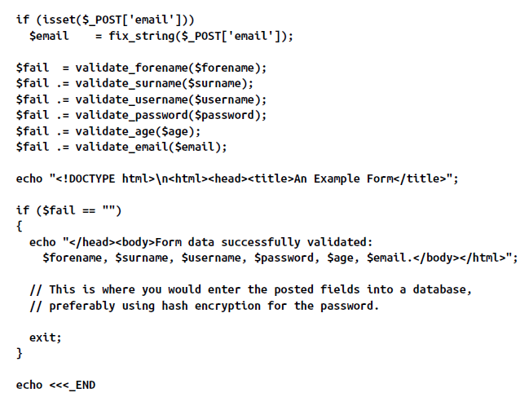

Slide 40
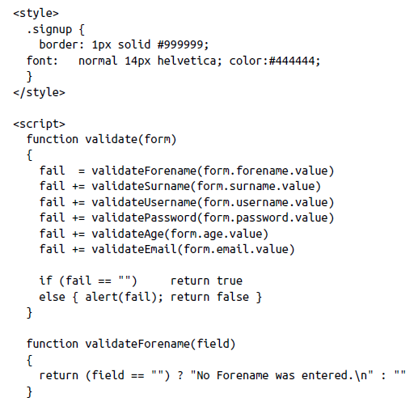
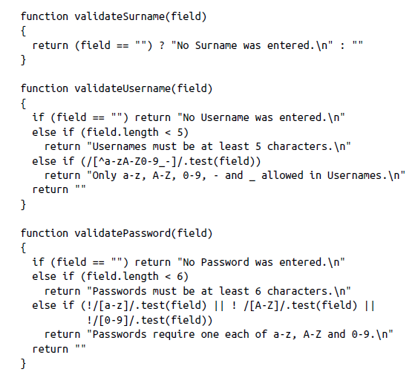

Slide 41
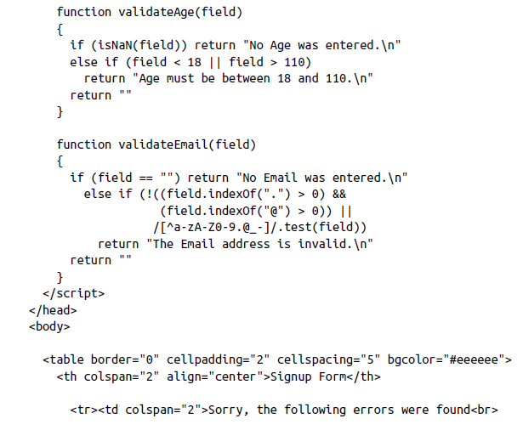
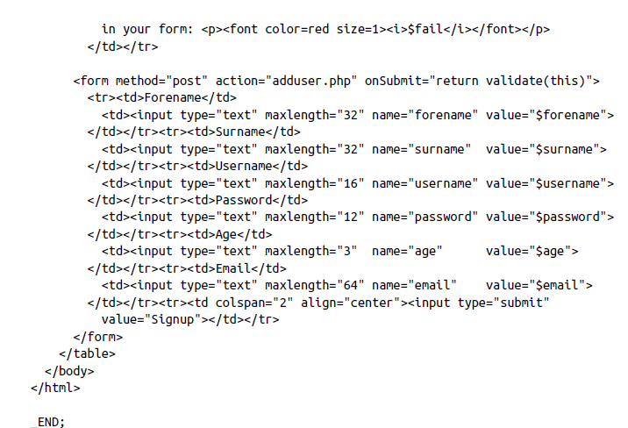

Slide 42
